Slide 1

ALY 6020: Predictive Analytics
Final Project: Building Predictive Models for 2 healthcare datasets
Submitted to: Mr. Michael Prokle
Date: 02/15/2023
Submitted by: Tanusha Erpula

Slide 2
Introduction
A healthcare company provided 2 datasets – Cancer mortality per capita and Stroke.
Cancer mortality describes the patients died due to cancer affected by various conditions such as income, geography, employment etc
Stroke dataset describes the patients who suffered with stroke with various conditions such as smoking, residence, age etc
Goal: The goal is to build predictive models to understand the death rate due to cancer and find if the patient could get stroke or not using conditions.

Slide 3
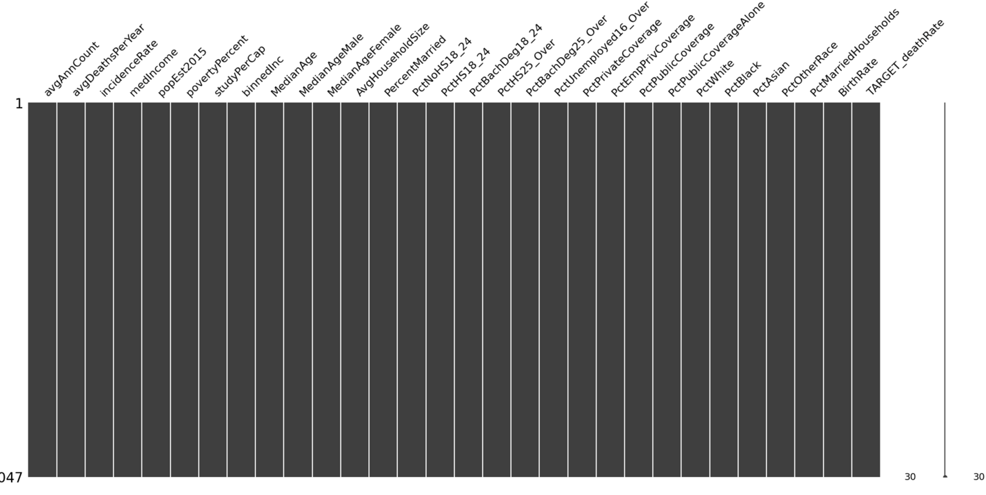
Data Exploration
Cancer dataset: The cancer dataset contains 3047 rows and 34 columns.
Removal of missing values, and, dropping columns which may not be useful for the prediction model is done as part of exploratory data analysis.

Slide 4
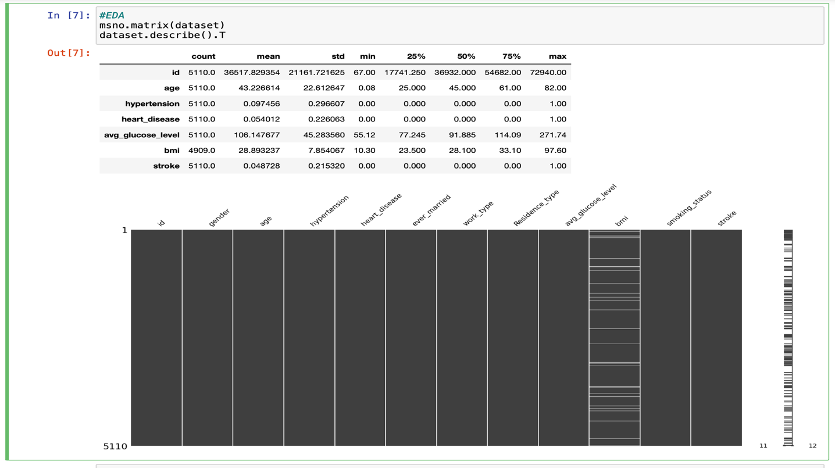
Stroke dataset: The stroke dataset contains 5110 rows and 12 columns.
Removal of missing values, and, dropping columns which may not contribute to build prediction model is done before building models.

Slide 5
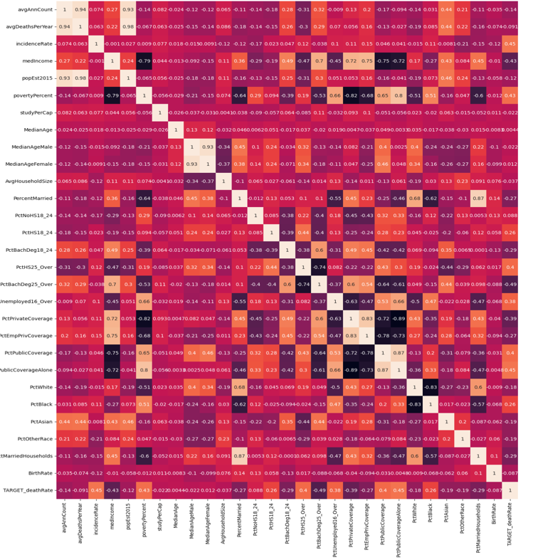
Data Analysis
Cancer dataset: A heat map is created to understand the correlation between variables and figure the dependent and independent variables to build prediction model.
The dependent variable here is ‘Target Deathrate’ while the independent variables are 'PctBachDeg25_Over', 'incidenceRate',
'PctPublicCoverageAlone', 'povertyPercent', 'medIncome’ etc

Slide 6
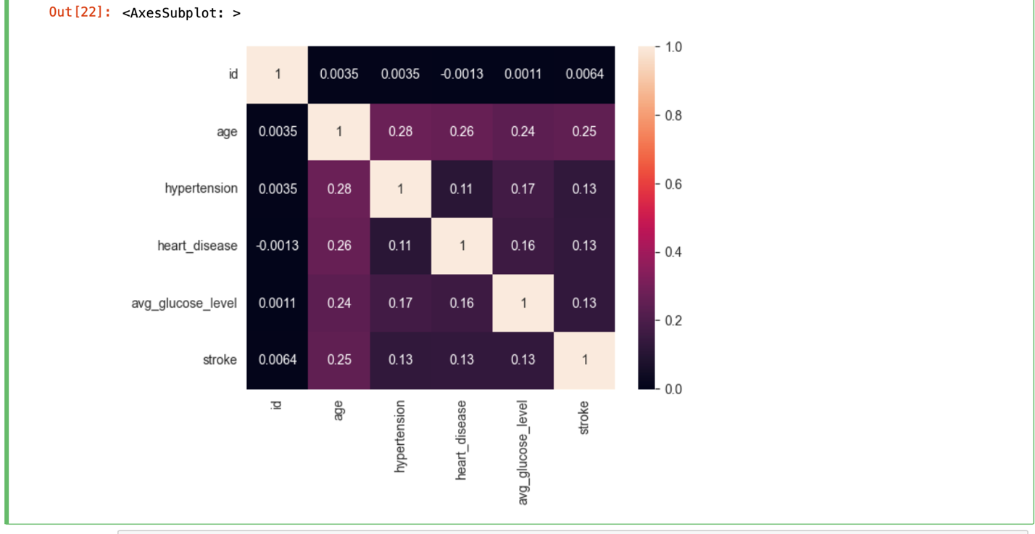
Data Analysis
Stroke dataset: Heat map is created to understand the correlation between the variables and find the dependent and independent variables to build the prediction model.
Here the Age, Glucose level, Hypertension and heart disease variables have the highest correlation among the other variables.

Slide 7
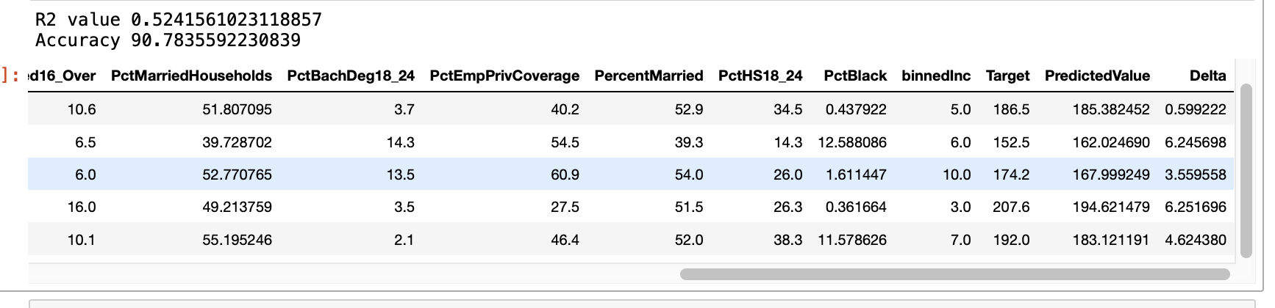
Prediction Model 1
Cancer dataset: Linear Regression
Using the dependent and independent variables, the linear regression model is built to predict the accuracy of the dataset. For that, the dataset is divided into 70:30 training and testing data.
Result: The accuracy of linear regression model is 90.78%.
Mean squared error is 444.82
Root mean squared error is 21.09

Slide 8
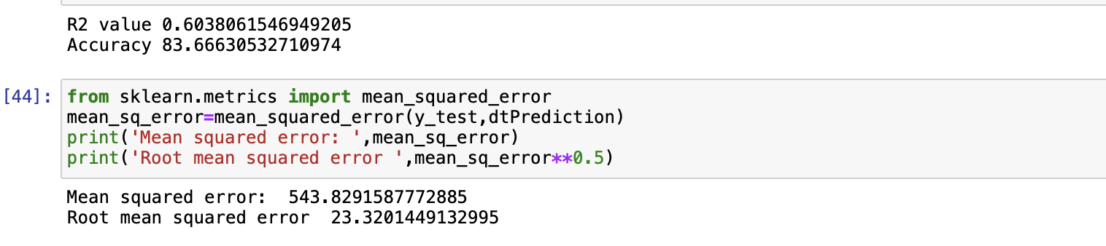
Prediction Model 2
Cancer dataset: Decision tree Regressor.
For the model, the dataset is split into 70:30 training and testing data. Using this, predictive model is built.
Result: The model accuracy is 83.66% which is lower than the linear regression model.
Mean squared error is 543.82
Root mean squared error is 23.32

Slide 9
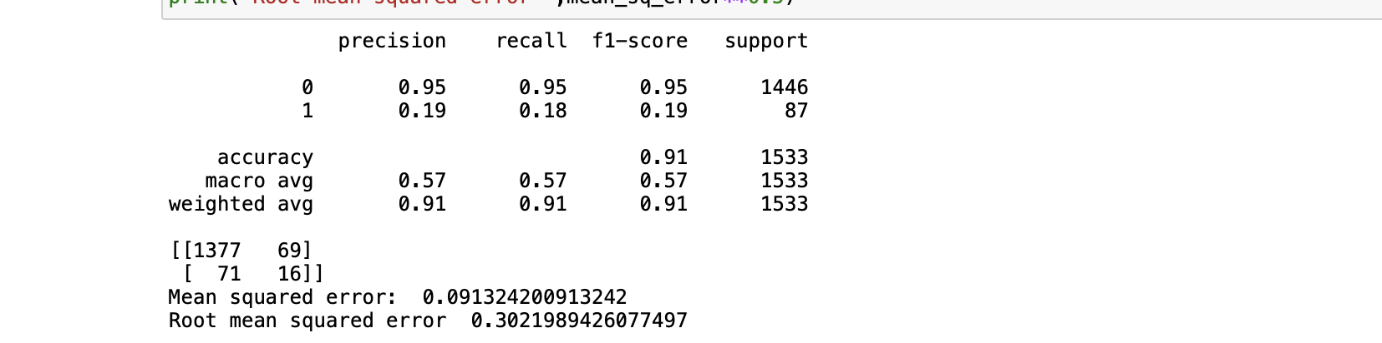
Prediction Model 1
Stroke dataset: Decision tree Classifier
The dataset is split into 70:30 training and testing data to built the predictive model to predict the accuracy of the dataset.
Results: The decision tree classifier model’s accuracy is 95%.
Mean squared error is 0.0913
Root mean squared error is 0.302

Slide 10
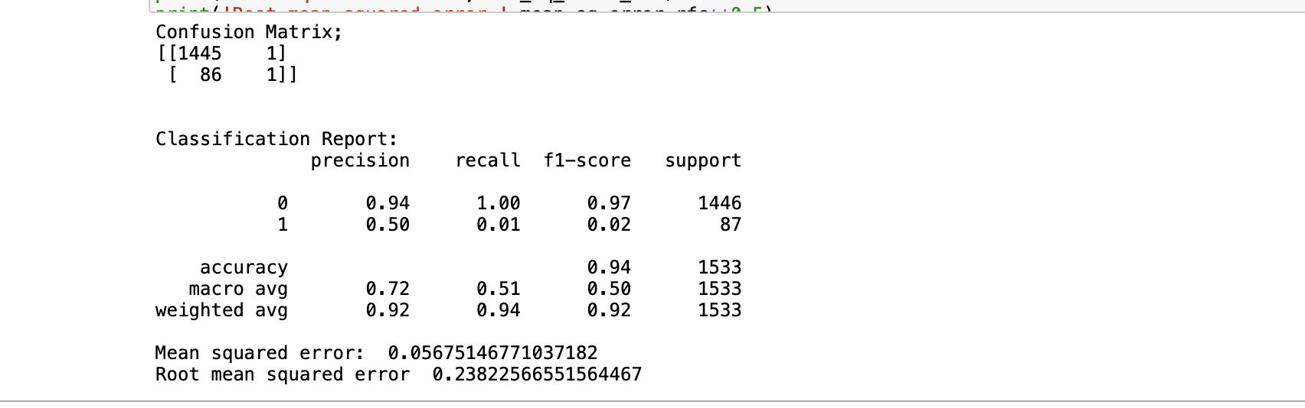
Predictive Model 2
Stroke dataset: Random Forest Classifier
The dataset is split into training data and testing data with 70:30 ratio.
Result: Random forest classifier model’s accuracy is 94%.
Mean squared error is 0.056
Root mean squared error is 0.238 is lower than the Decision tree classifier.

Slide 11
Conclusion
Each dataset depicts a characteristic which helps to identify the results.
Cancer dataset has accuracy of 90.78% which predicts the deathrate accuracy due to cancer.
Stroke dataset has accuracy of 95% which predicts the number of people who suffered the stroke.
Using these results, health care professionals can diagnose better and provide patients with better treatment.
Health insurance companies can use these models to understand the patient's mortality and provide better health insurance plans saving their lives.

Slide 12

References
Decision tree algorithm, explained. KDnuggets. (n.d.). Retrieved February 18, 2023, from https://www.kdnuggets.com/2020/01/decision-tree-algorithm-explained.html
Guanga, A. (2019, April 10). Machine learning series day 6 (decision Tree Regressor). Medium. Retrieved February 18, 2023, from https://becominghuman.ai/machine-learning-series-day-6-decision-tree-regressor-82a2e2f873a

Slide 13

THANK YOU!

